Slide 1
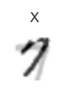
Experiment:
Train many autoencoders
Make 1 overfit
Compare the data generation results with the same samples
Hypothesis: The overfit one creates a mess

